Slide 1
What my Past Self Told me About Tomorrow
Chris C
Notes:
Summary:

Slide 2


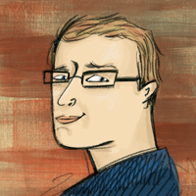

Who am I? (i.e. Shameless Self Promotion)
Software Consultant https://saturdaymp.com chris.cumming@saturdaymp.com Host of: http://weeklydevchat.com/ https://www.legacycode.rocks/
Slacks Chris C on Dev Edmonton Legacy Code Rocks yegsec
Notes:
Come join us at the Weekly Dev Chat (every Tuesday @ 12pm) or Legacy Code Rocks (every Wednesday @ 11am).

Slide 3
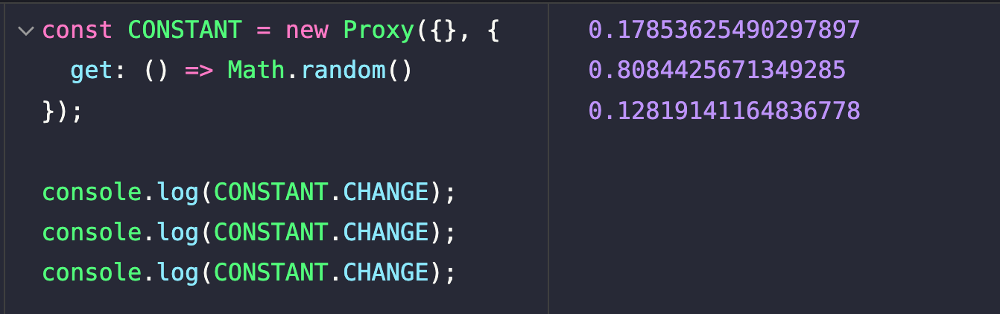
The Only Thing Constant is Change
Notes:
Life is full of changes. Be ready to adapt to reality. Give me the power to accept things I cannot change, the courage to change the things I can, and the wisdom to know the difference.
I have changed of the years and am not the same person I was 20 years ago. Technology has also changed and we don’t develop software the way we did 20 years ago.

Slide 4
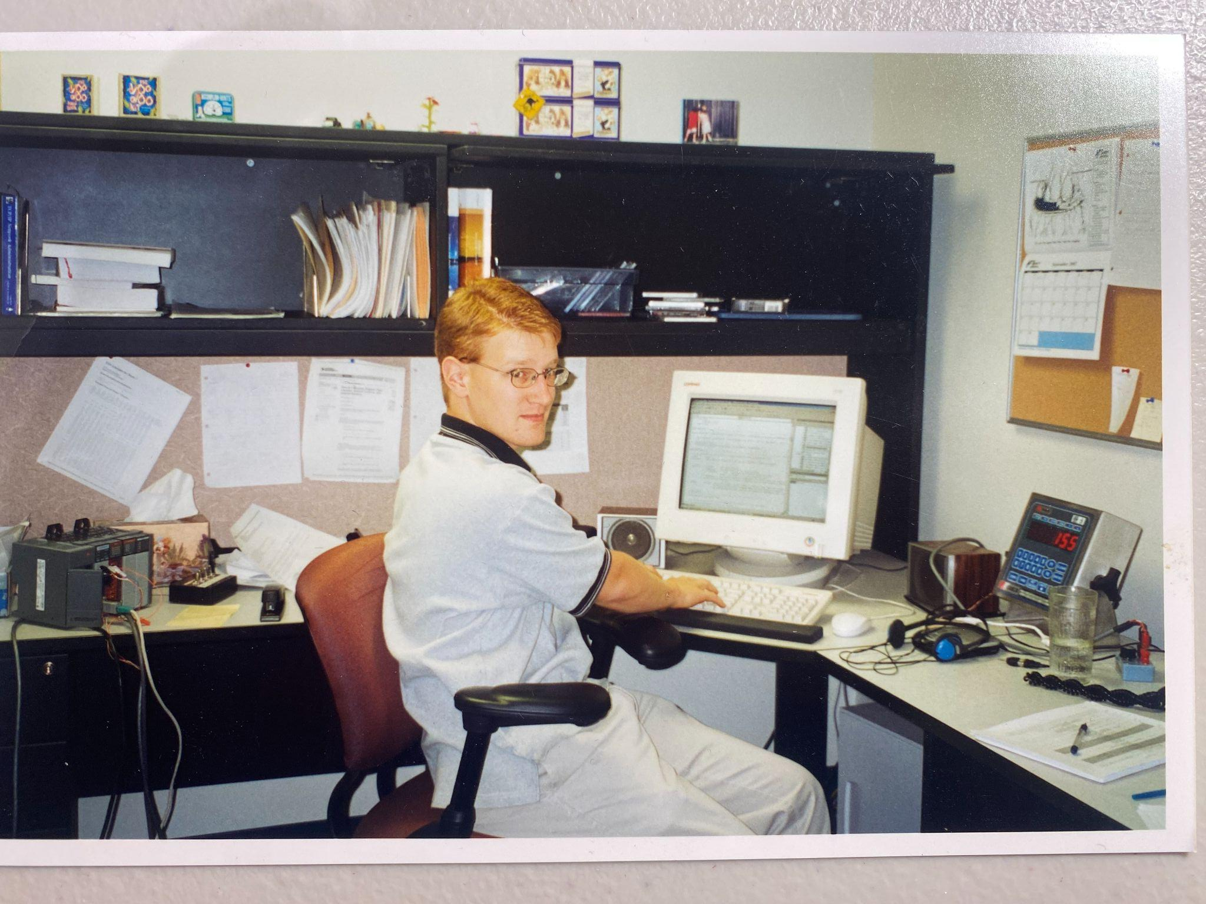
Past and Present Self
Notes:
I’m 47, soon to be 48 years old. I got interested in software development when we discovered we could make our own Doom 2 (1994) levels. First home computer was a Commodore 64 that I played games on and “copied” Monster Manual entries.
Bought my first computer in high school. Can’t remember if it was a 386 or 486.
Took computing science at U of A. During that time did TA work and also Telus Advertising Services (phone books). Did an internship where my first professional language was VB6.
Next job was VB.NET 1.1 and then 2.0. Worked in the .NET ecosystem for many years. Dabbled in Rails.
Started Saturday MP in 2009. Stayed in the .NET ecosystem for many years.
Worked with a company in the states that specialized in legacy code. Did Rails, PHP, .NET, etc.
Recently did some work on a code I wrote 20 years ago. Was a interesting experience.
Currently client work is slow so I’m working on side projects, WDC, etc.

Slide 5
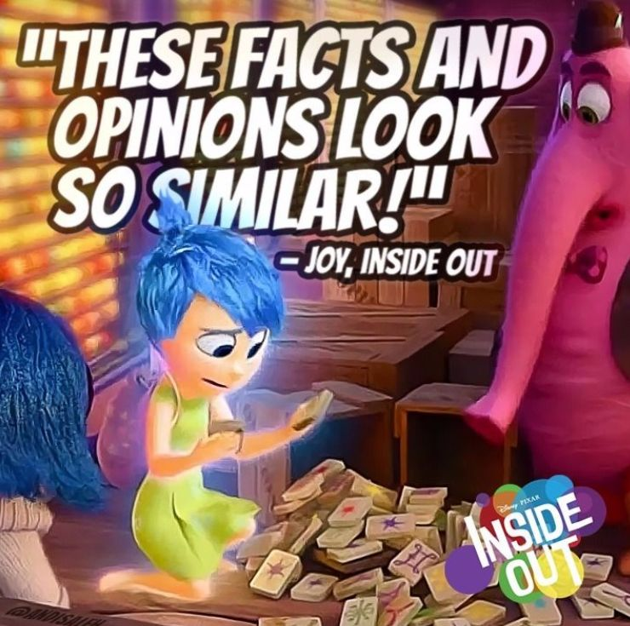
Disclamer
Notes:
These is my advice and predictions based on my experiences. Adjust as needed for your own situation.
Advice is worth what you pay for it.

Slide 6
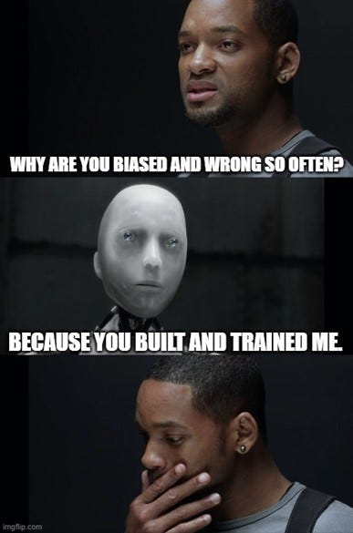
Tomorrow - AI
Notes:
You should always use the best tool to get the job done. Make sure you are trying AI (coding agents, LLMs, etc) to see when it should and shouldn’t be used.
AI will be another abstraction. We went from bits, to assembly, to compiled languages (C), interpreted languages (Java, JavaScript, Ruby, Python), and now LLMs. Java was write once and debug everywhere. Languages like Ruby try hard to be human readable (i.e. a non-developer could understand what it’s doing). LLMs allow programming in human language. This will lower the barrier to entry.
Get good at reading code. Before Coding Agents most developers spent most of their time reading code. Now it will be even more time reading code.
You are still responsible for the code generated by the LLM!!!
Deterministic AI (agents, LLMs, something else) will exist. For now use AI to create a deterministic script/app.
Things get slowly better over time.

Slide 7

Tomorrow - Qualifications and Regulations
Notes:
Software development will become a trade or professional occupation that will have best practices turned into regulations certifications. Likely start in certain industries or companies. Likely require a serious event/mistake and be implemented.
There will be a better distinction between Scientist, Engineer, and Developer. I think this distinction will be important. I think Engineer approved applications will become a thing.

Slide 8
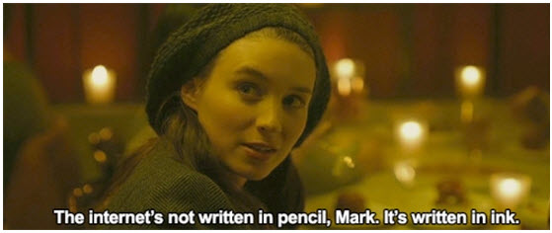
Tomorrow - Security and Privacy
Notes:
Privacy is a losing game. Most of your info is likely out there if people want it. You have likely given most of it willingly (Facebook and other social media).
Have I been pwned website.
It will become more important to prove it’s you.
Don’t lose your access to your email, phone number, or phone.
Use 2-factor.
The Internet is written in ink. Be careful what you put out there.

Slide 9
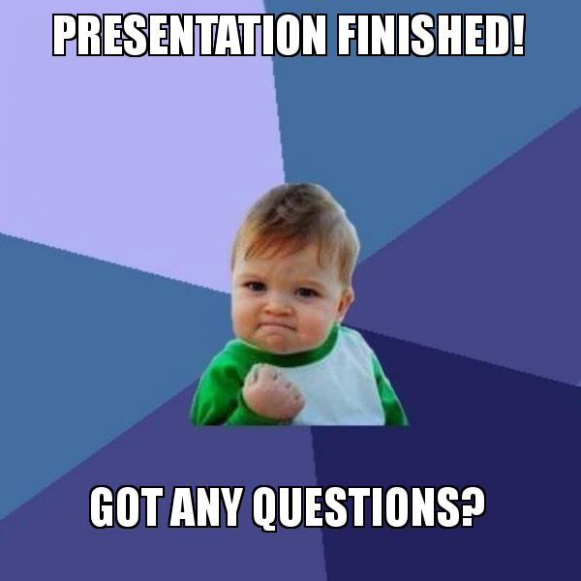
Questions?
Notes:
Random non-tech related advice in-case there was not questions. Or a reminder of
4 items to work on: Body, Mind, Social, and Finances
Exercise. We sit at a desk all day. I gained weight and didn’t like it.
Mind. Not as worried about it.
Social: Don’t just have online friends. Have friends that will help you move a couch, visit you in the hospital, etc.
Finances: Avoid debt, invest, spend less than you make.
I get asked often how to get a job and I’m not sure as I’ve been a consultant. My advice is to get references, meet people, etc. Most of my clients are through friend of friend. Recently updating my own resume and it has been a learning experience.
All relationships end. Death is the ultimate ending but most will end before that, especially professional ones. End relationships on a positive note, if possible, and worst case with dignity and integrity. Leave a trail of happiness behind you in work and life.
Independence is not doing everything yourself. It’s knowing when to ask for help and when to help others.

Slide 10
More Questions?
Email: chris.cumming@saturdaymp.com
Slack: Dev Edmonton Legacy Code Rocks yegsec
Join: http://weeklydevchat.com/ https://www.legacycode.rocks/
Notes:
Thank the audience.

